Slide 1
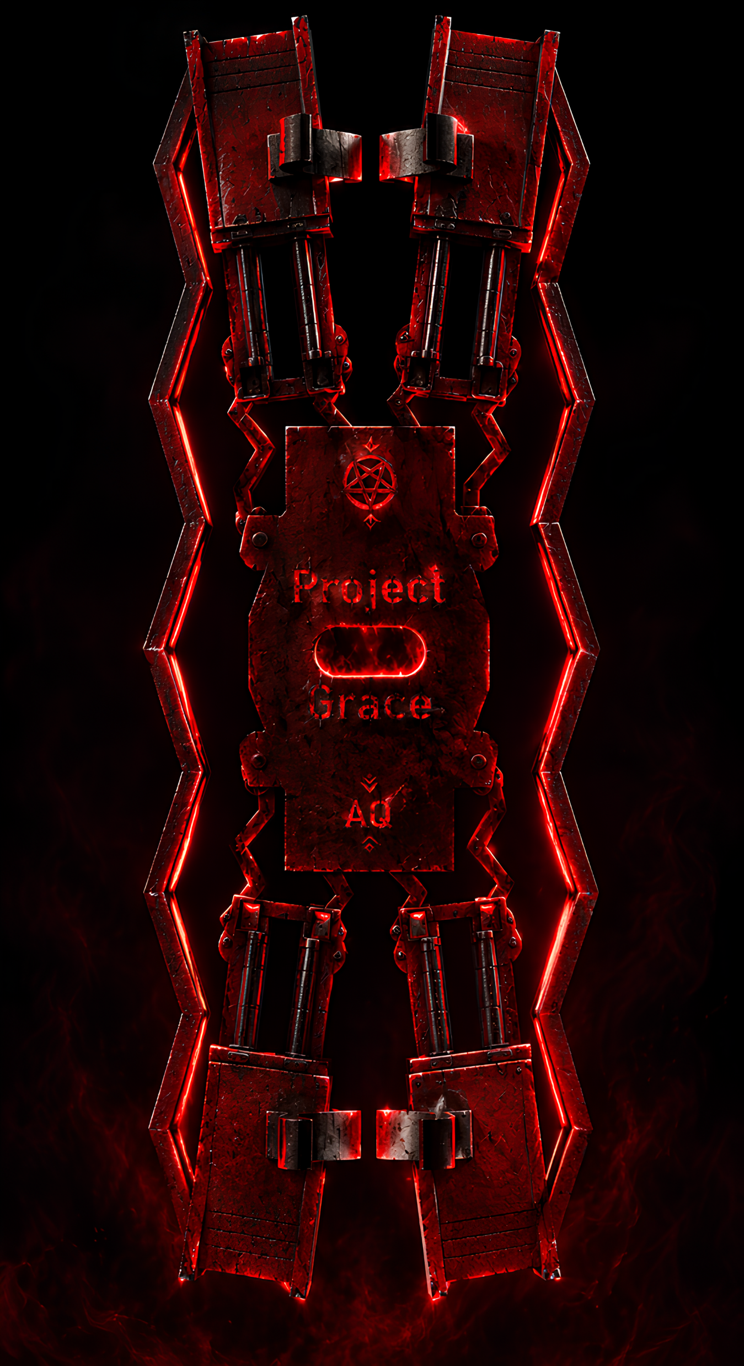
Akbar Qamar
The Rite of Ascent

Slide 2
In the workshop’s ledger, it is called Project Grace: a machine conceived to climb the copper pillar and return carrying its burden. Four driven wheel stations clasp the pipe, while paired spring arms press inward, yielding to small imperfections without surrendering their hold. Their twin flexures are spaced to resist twisting; the custom double-cone wheels leave a relieved waist for the pipe and shaped seats to retain their tires.
At the roof of each motor mount, a split keeper waits above the wheel station: a secondary safeguard, separate from the primary grip.
The central plate bears the wiring passage and the marks of its makers, while the controller provides a deliberate start, a green signal in motion, and a quiet shimmer while at rest.
Grace is not merely a frame around motors. It is a study in balance: rigid where force must travel, compliant where the pipe demands adaptation, and restrained where failure would mean a fall. Each spring, wheel, and keeper has its place in the ascent.
The machine is still being tested. Its grip, spring travel, and retention must be proven on the pipe before the climb is trusted.
Only then will the design’s promise become performance.

Slide 3
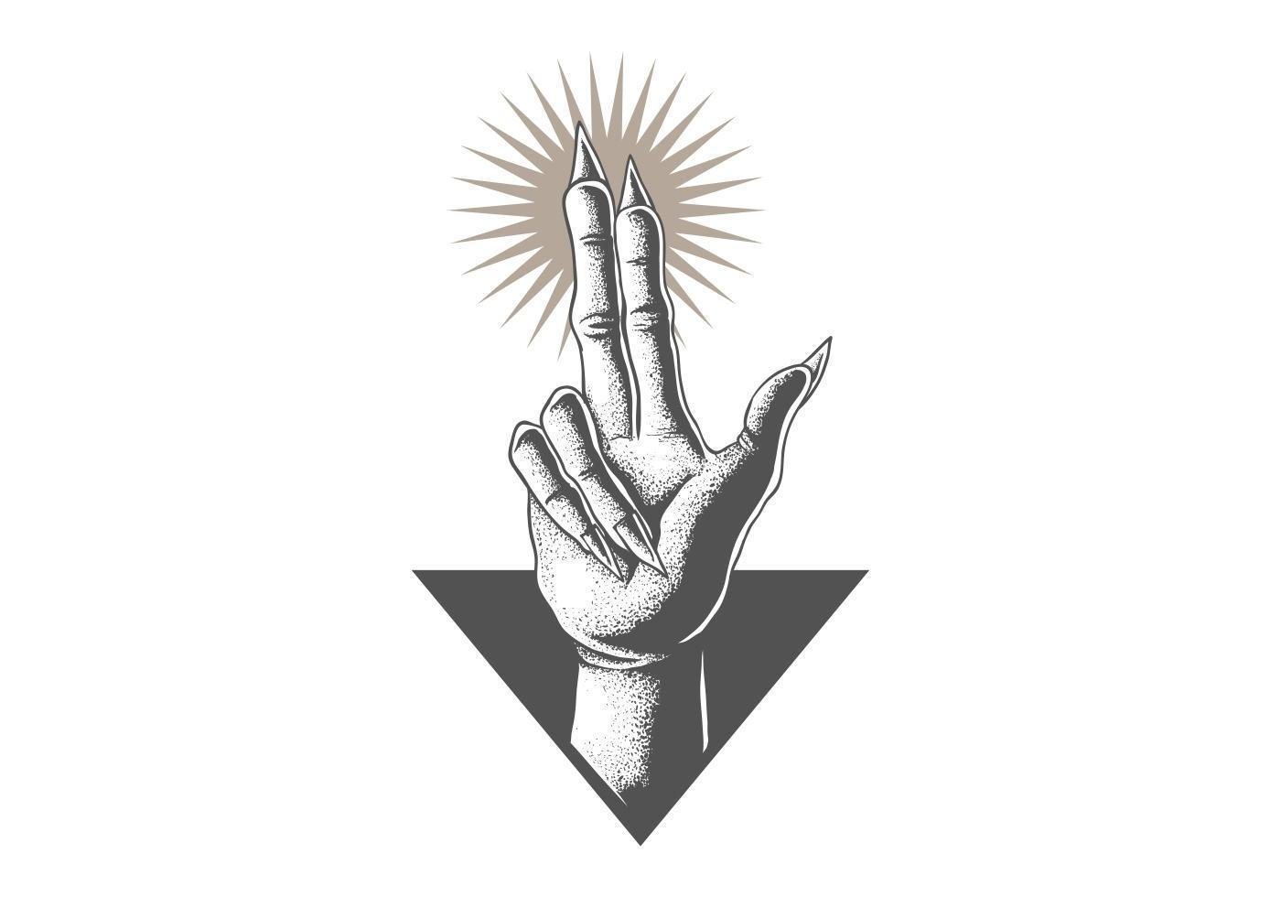

Four-wheel drive for climbing a vertical pipe
Compliant spring arms to maintain wheel contact
Paired flexures designed to resist unwanted arm twist
Reinforced motor mounts with adhesive-keying floor ridges
Custom double-cone wheels shaped for pipe clearance
Grooved tire seats to help keep the tires in place
Split snap-on pipe guides for added retention
Central electronics plate with wire-routing clearance
Integrated servo mount retained in the design for future use
Button-operated motor control
LED status lighting with an idle animation
Designed around a 22 mm copper pipe

Slide 4
We were not made for the floor.
We were not given stillness.
Let the hollow become strength.
Let the turning become law.
Let every measured fragment answer the call to rise.
There is no level ground.
There is no gentle path.
There is only the line above us, and the will to take it.
Grace, take hold.
Grace, refuse the fall.
Grace, climb.
When the weight speaks, we answer with motion.
When the distance widens, we answer with force.
When the path stands silent and vertical, we answer by ascending.
We cast away what is weak.
We keep only what endures.

Slide 5
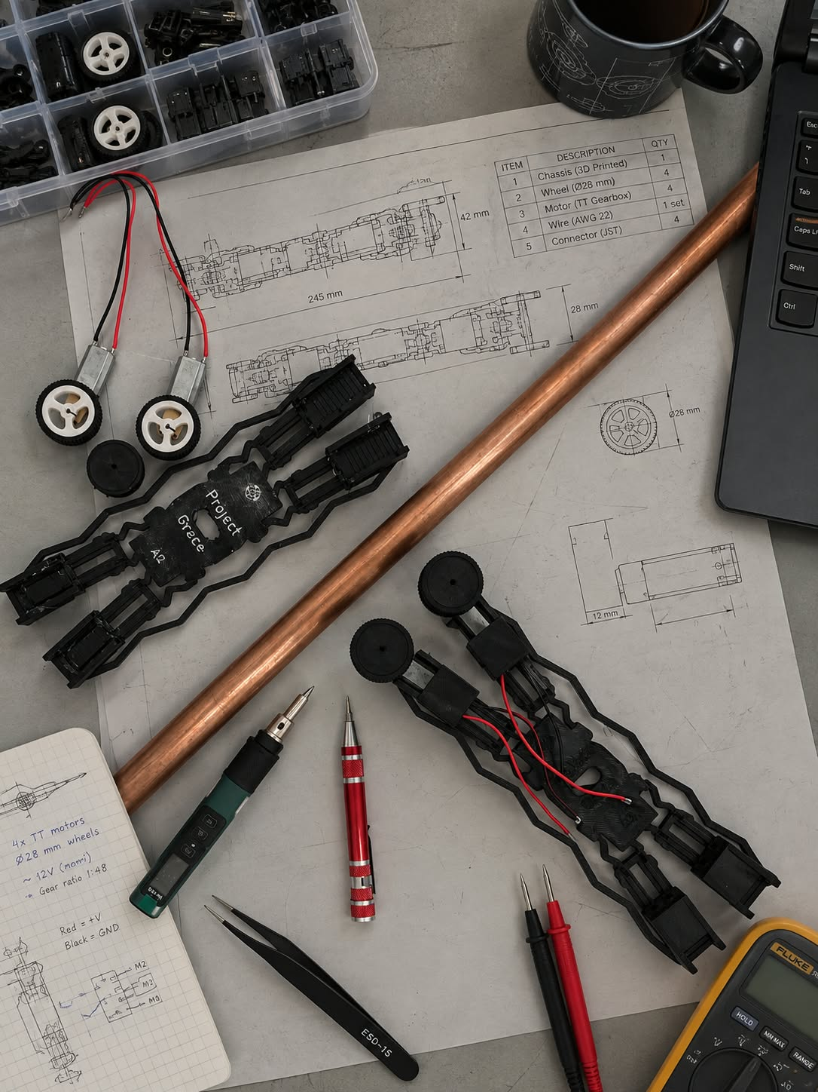

Slide 6
The Discipline of the Climb
A pipe is not a perfect guide. It may be slightly out of plumb; its surface may vary; the machine may meet resistance as it climbs. The design therefore avoids relying on one rigid point of contact. Four driven wheels share the task, while spring arms press the wheel pairs toward the pipe. The arms are intended to yield enough to accommodate small variations, but not so much that the machine loses its grip.
Compliance must be controlled. Paired flexures allow movement in the intended direction, while their spacing and rigid connections resist unwanted twisting. The frame is strengthened where loads enter the arms and motor mounts; the spring sections remain free to move. Strength belongs at the joints. Flex belongs in the spring.
The wheels follow the same idea. Their double-cone profile creates a relieved centre for the pipe, while the tire seats give the rubber a defined place to rest. The motor mounts support and locate the motors without obscuring the moving parts or preventing adjustment. Each feature has a purpose: grip, alignment, support, or access.

Slide 7
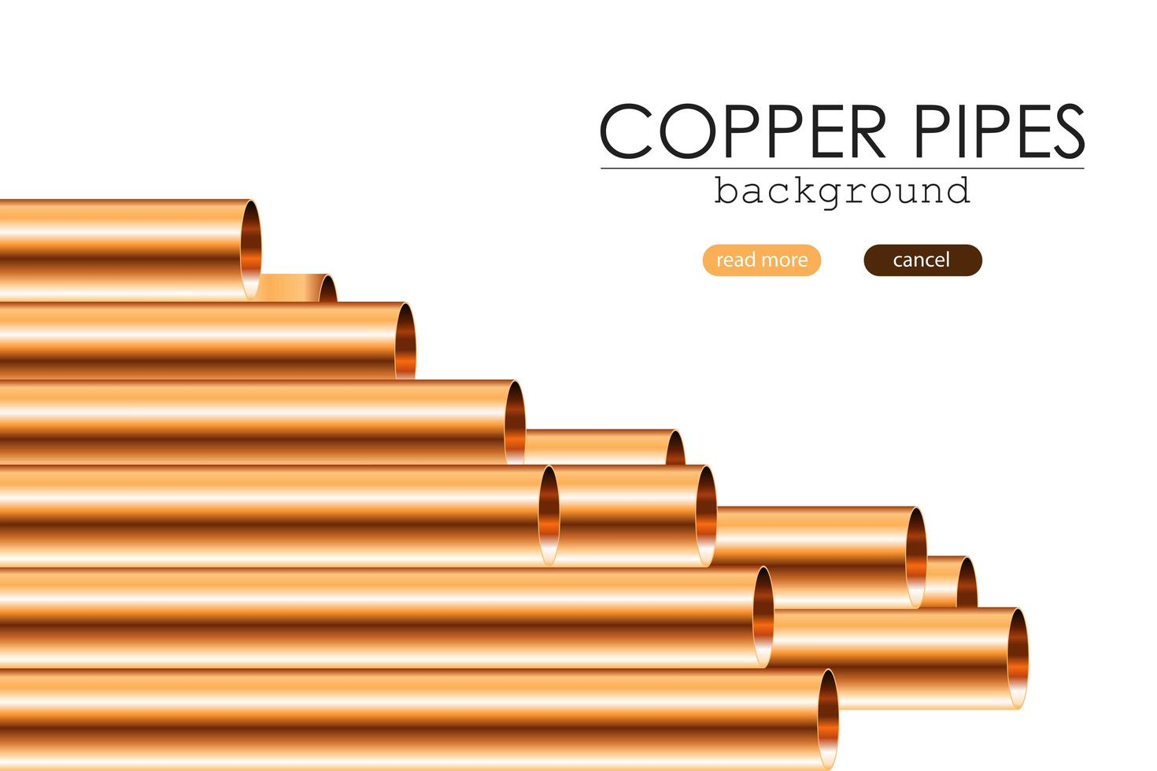
Project Grace is also designed to be understood and repaired. Its structure is visible. Its motors, wheels, wiring, and controller can be inspected separately. The central plate provides a place for electronics, and the frame is kept within the competition envelope. Simplicity is not the absence of design; it is the removal of features that do not serve the mission.
Above all, the design treats safety as part of performance. A keeper around the pipe is a secondary safeguard, not a substitute for reliable wheel contact. A soft landing is a control strategy, not a reason to leave weak joints untested. The machine must be tested repeatedly, under increasing load, before its grip and structure are trusted.
Grace is therefore not designed to resist every movement. It is designed to distinguish between useful movement and failure: flexible where the pipe demands adaptation, rigid where the load must be carried, and cautious wherever a mistake could become a fall.

Slide 8
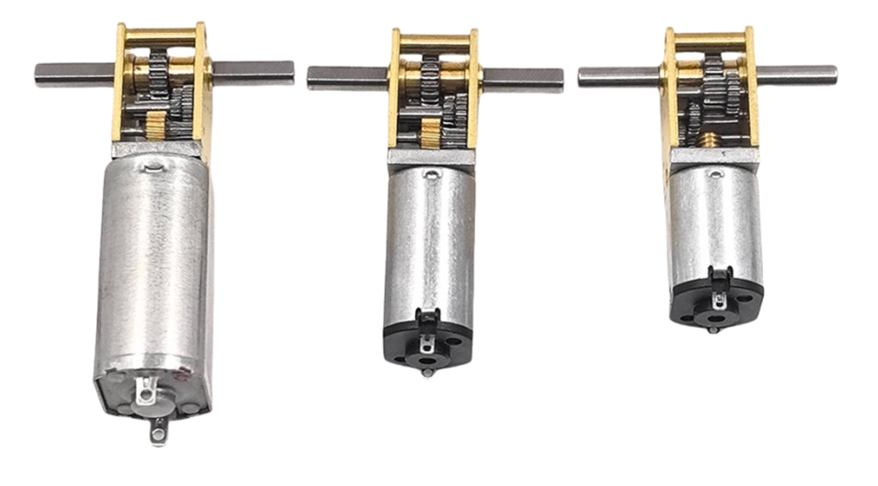
Drive System
Project Grace uses compact N20-format 050 metal gearmotors with an approximate rated speed of 200 rpm at 12V. To pursue higher climbing speed, the motors are being driven at 15 V as an overdrive condition, above their nominal operating rating.
Operating the compact motors above their nominal voltage is intended to increase speed and available output from the same lightweight drive units. If testing confirms the motors and gearboxes can handle the extra load, this can improve the vehicle’s performance-to-weight ratio without adding heavier motors. The benefit must be balanced against increased current, heat and wear.
050 n30 N20

Slide 9
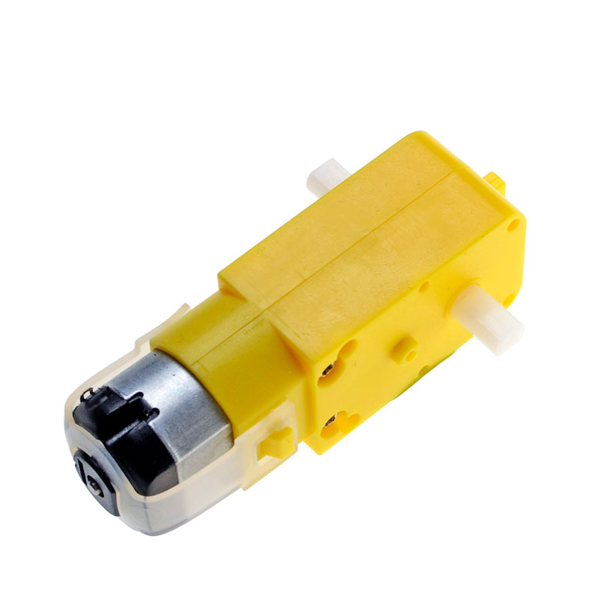
Low performance
TT Geared motor

Slide 10
A Small Brain for a Lightweight Climber
Project Grace uses a compact ESP32-C3 Mini as its onboard controller. Its small footprint and low mass suit a machine that must carry its own electronics while climbing: less weight for the wheels to lift, and more room on the centre plate for the battery, wiring, and supporting components.
Despite its size, the controller provides enough processing capacity and GPIO connections for the vehicle’s control tasks. The current firmware reads a start button, switches the motors through an external driver, and controls a 12-pixel RGB LED ring. The motor driver supplies the motor current; the ESP32-C3 provides the control signals rather than powering the motors directly.
The controller is intended to support the sequence-based operation the challenge requires. Timing, position sensing, and other mission steps can be added as the hardware develops. Wireless functions are not used for competition operation.
The choice reflects the project’s wider approach: use a controller that is compact and capable, but keep the complete system light, self-contained, and straightforward to understand.

Slide 11
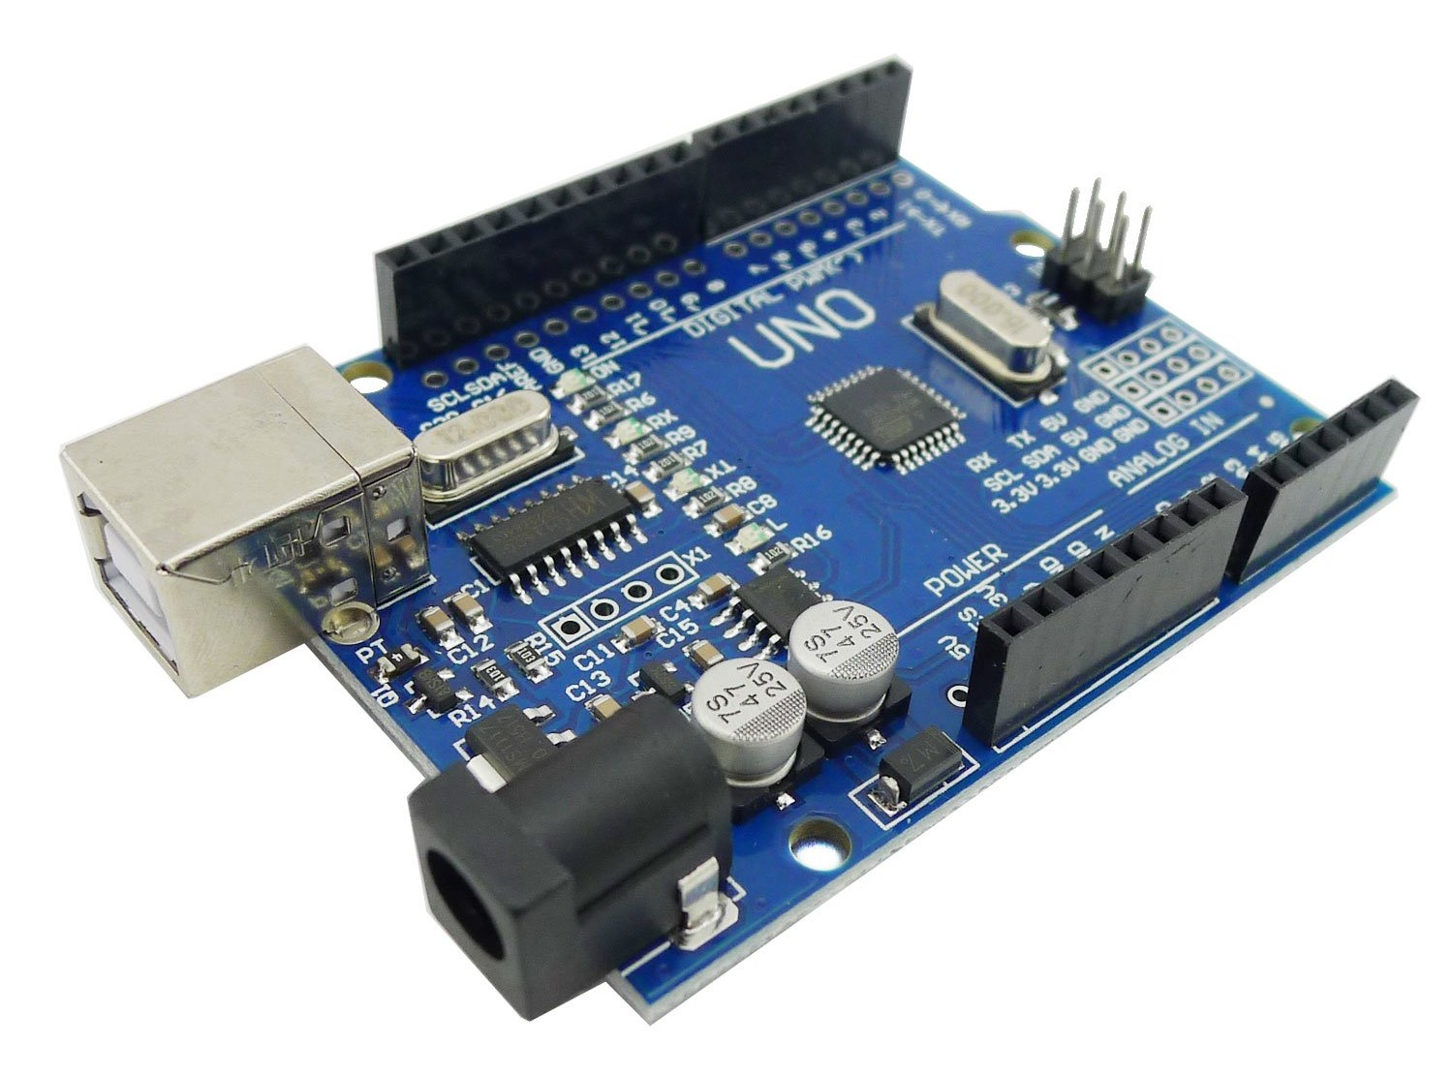
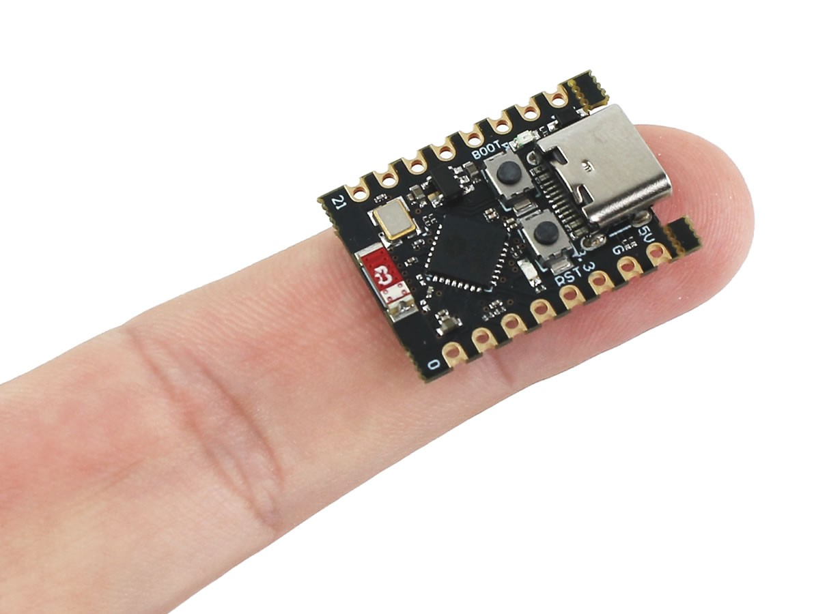

Slide 12
Voltage Headroom for the Drive System
Project Grace uses an L298N dual H-bridge motor-driver board to control its geared DC motors. Smaller driver modules were considered, but the candidate boards’ motor-voltage ratings did not provide enough margin for the planned supply. The L298N’s motor supply is rated up to 46 V, giving substantial voltage headroom for the project’s sub-15 V bus.
The driver switches motor direction and speed under commands from the ESP32-C3. The motors draw their power from the battery through the driver; the microcontroller sends only the control signals.
Voltage rating alone does not determine whether a driver is suitable. The L298N is an older bipolar design and loses more voltage as heat than modern MOSFET-based drivers. Its current capacity also depends on the module’s heatsinking, motor load, and operating conditions. For Project Grace, motor current and driver temperature should be checked under climbing and stall conditions, particularly if the motors are overdriven.
The L298N was selected for its supply-voltage headroom and accessible dual-motor control. Its performance must still be validated with the chosen motors and battery.

Slide 13
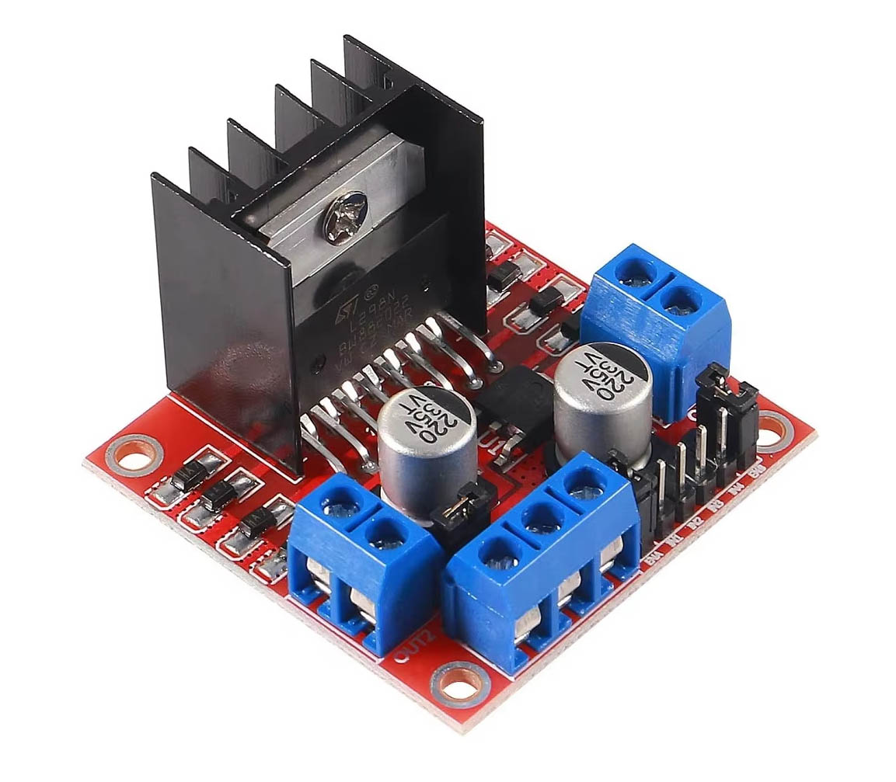
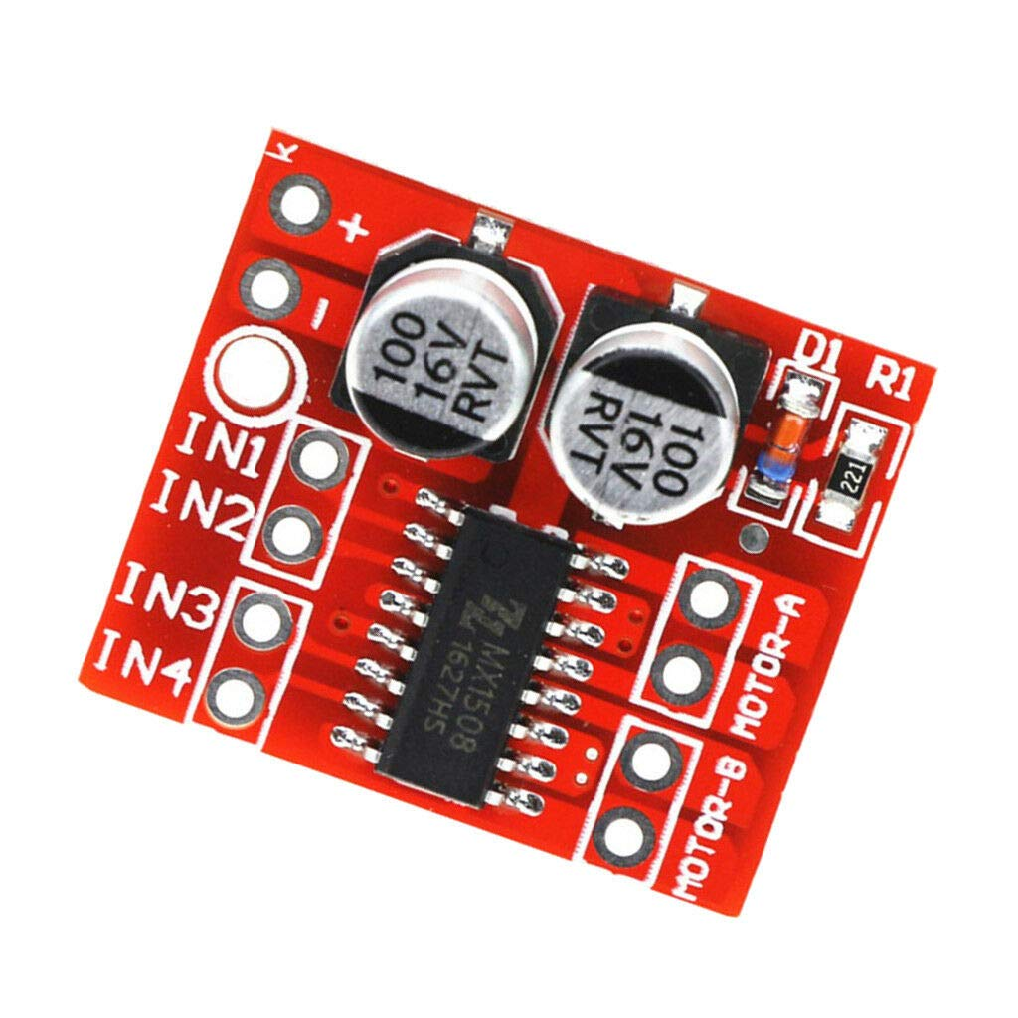
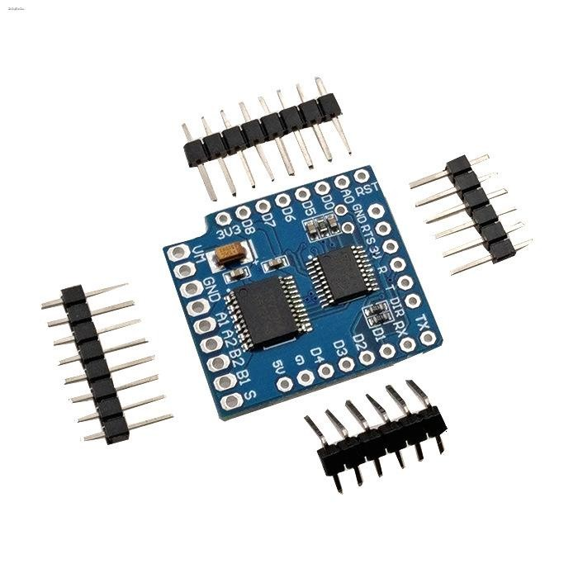

Slide 14
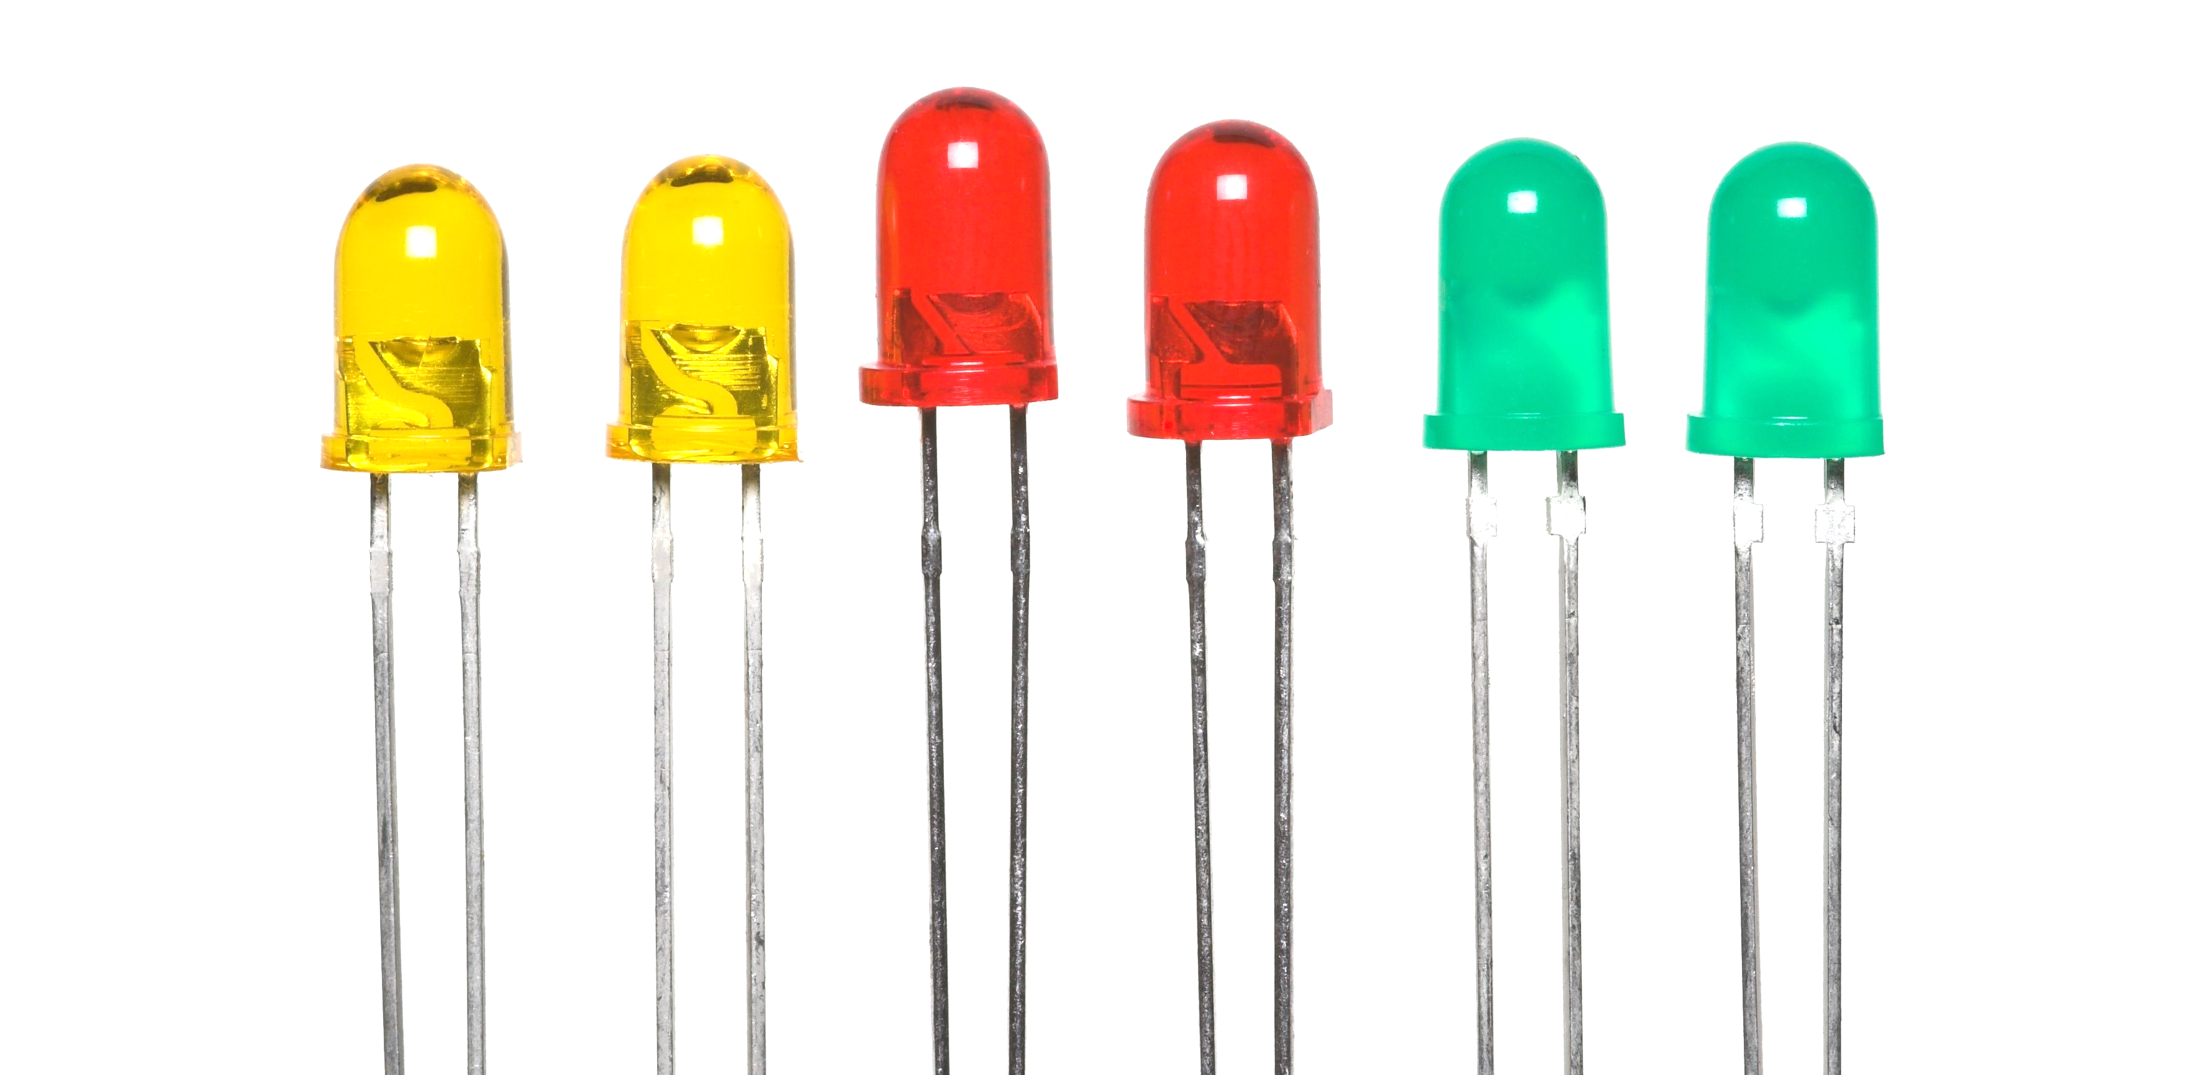
A Ring of Addressable Light
Project Grace uses a WS2812 RGB LED ring, controlled through a single data pin. Each LED is individually addressable, allowing the ESP32-C3 to set colours and patterns around the ring without needing a separate control wire for every light.
The ring gives the vehicle a clear visual identity during operation. In the current controller program, it displays a colourful sparkle animation while idle and changes to green when the motors are running. Its brightness can be adjusted in software, helping the status remain visible without drawing more power than necessary.
The ring was chosen for its compact form, simple wiring, and flexibility for animation. It provides an immediate visual cue to judges and spectators, helping Project Grace stand out while also communicating its operating state.

Slide 15
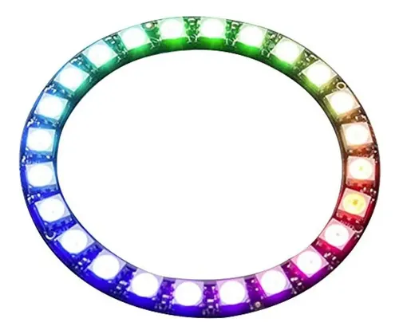
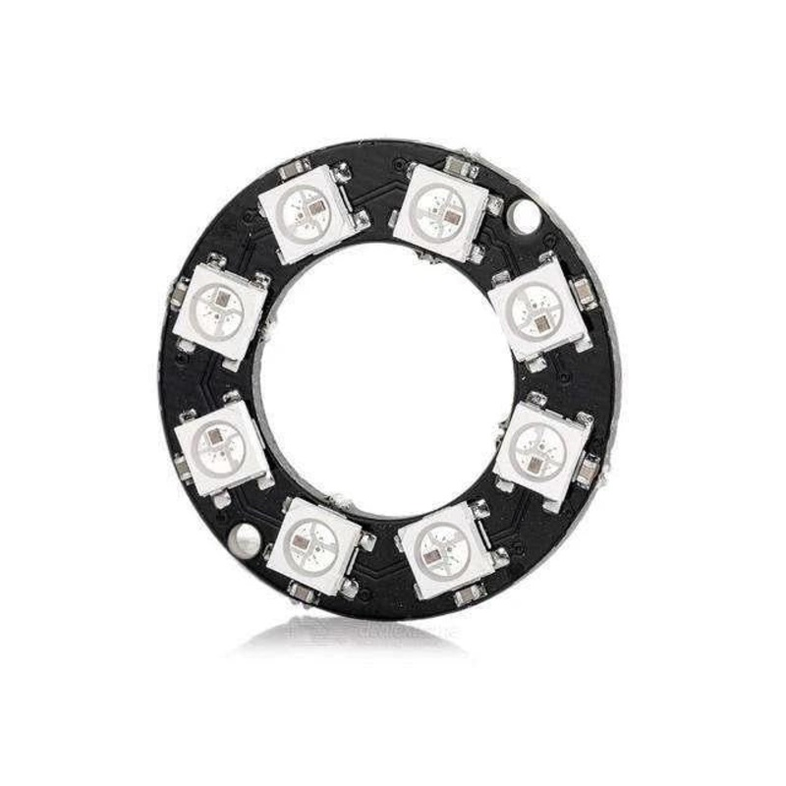

Slide 16
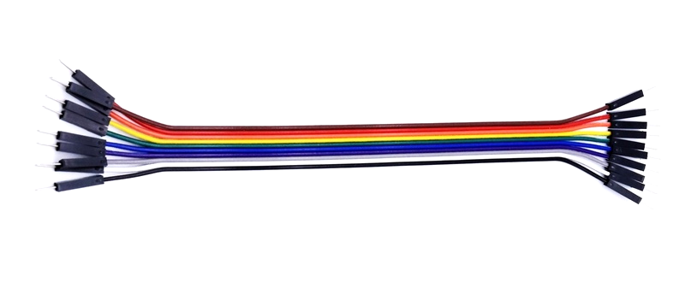
Metal Gears for a Demanding Task
Project Grace uses an MG90S micro servo to operate the chain-release mechanism. Compared with the familiar blue 9 g servo, the MG90S has a metal gear train that is better suited to repeated loading and impact. This makes it a more robust choice for controlling the release of the hanging chain.
The chain load is approximately 300 g. That load is not necessarily carried directly by the servo gears: the mechanism’s geometry determines how much force and torque reach the servo. The servo horn, linkage, mounting, and release point must all be designed to avoid excessive leverage on the output shaft.
The MG90S was selected for its compact size and metal gears, providing a stronger-feeling option for this mechanism without adding a large actuator. Its holding ability still needs to be verified with the finished linkage and a controlled load test; metal gears alone do not guarantee that the servo can safely support the full chain load.

Slide 17
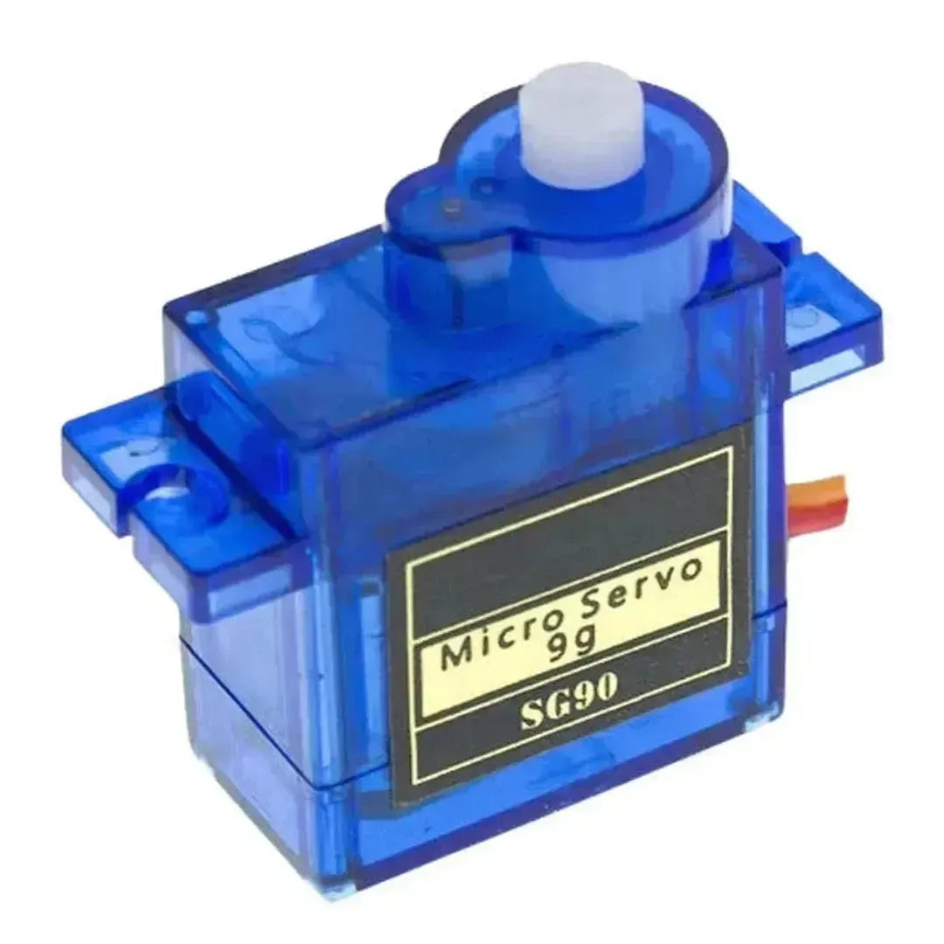
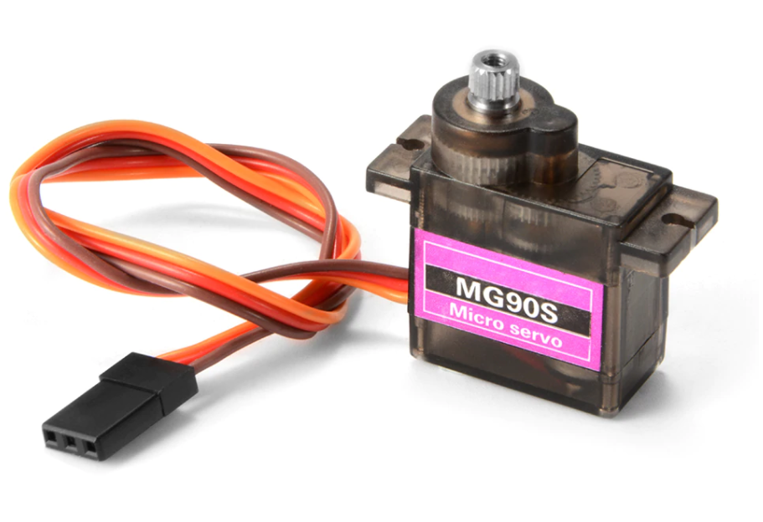

Slide 18
Choice of filament
Project Grace’s spring arms and accordion flexures are designed to deflect as the wheels grip the pipe. Their dimensions were selected around PETG’s balance of stiffness, toughness and strain capacity. The material must flex under load, return toward its original shape, and tolerate repeated movement without cracking. PETG can also creep under sustained load, especially when warm, so long-term wheel preload still needs testing.
Changing filament changes the frame’s mechanical response. PLA is generally stiffer than PETG; the same flexure may deflect less under load, increasing stress around beam roots and joints. ABS may be more compliant than PLA, but its shrinkage and warping can alter alignment and wheel spacing. Actual properties depend on filament grade and print settings.
Layer orientation and adhesion also affect flexure strength and fatigue life. After printing, cycle the arms and inspect for cracks, delamination or permanent bending. Treat PLA or ABS as a material change: test the printed frame and adjust flexure geometry or preload if required.

Slide 19
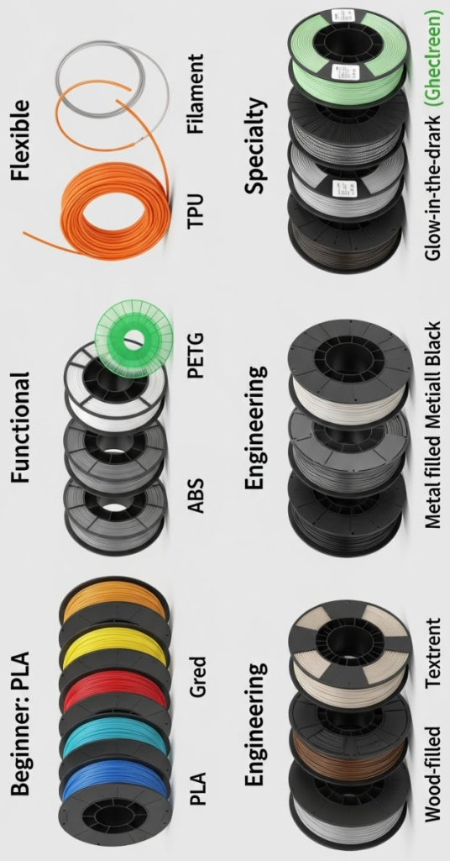

Slide 20
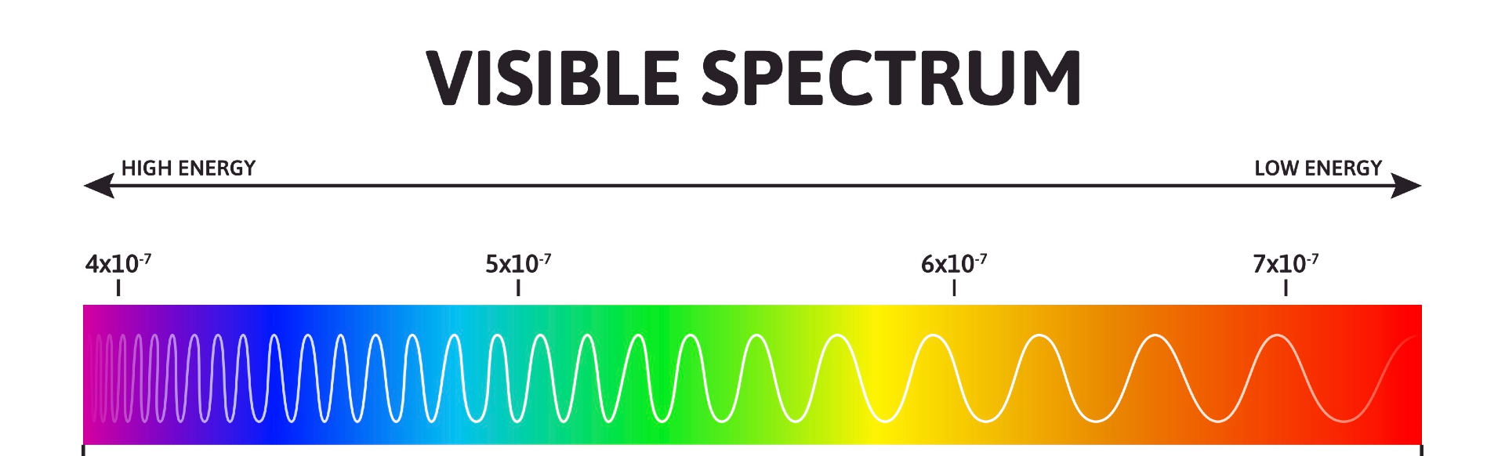
Blood red in sacrifice
Red was chosen as more than a colour. It is the mark of life moving through the machine: warmth, effort and persistence made visible. Like blood, it signifies what must keep flowing for the body to endure. In Project Grace, that image belongs to the frame—not as decoration, but as a reminder that every part has a purpose in the act of ascent.
The red body stands against the pipe, the workshop and the ordinary grey of unmade things. It makes the mechanism unmistakable: a signal of intent, a small banner raised before the climb begins. Each arm bends; each wheel holds; each spring returns. The colour gathers those separate motions into one identity.
Red also carries a warning within its beauty. This machine depends on sound material, careful assembly and tested flexures. It must be built with respect for its limits. The colour is therefore both vow and witness: Grace will reach upward, but only through the strength prepared beneath it.

Slide 21
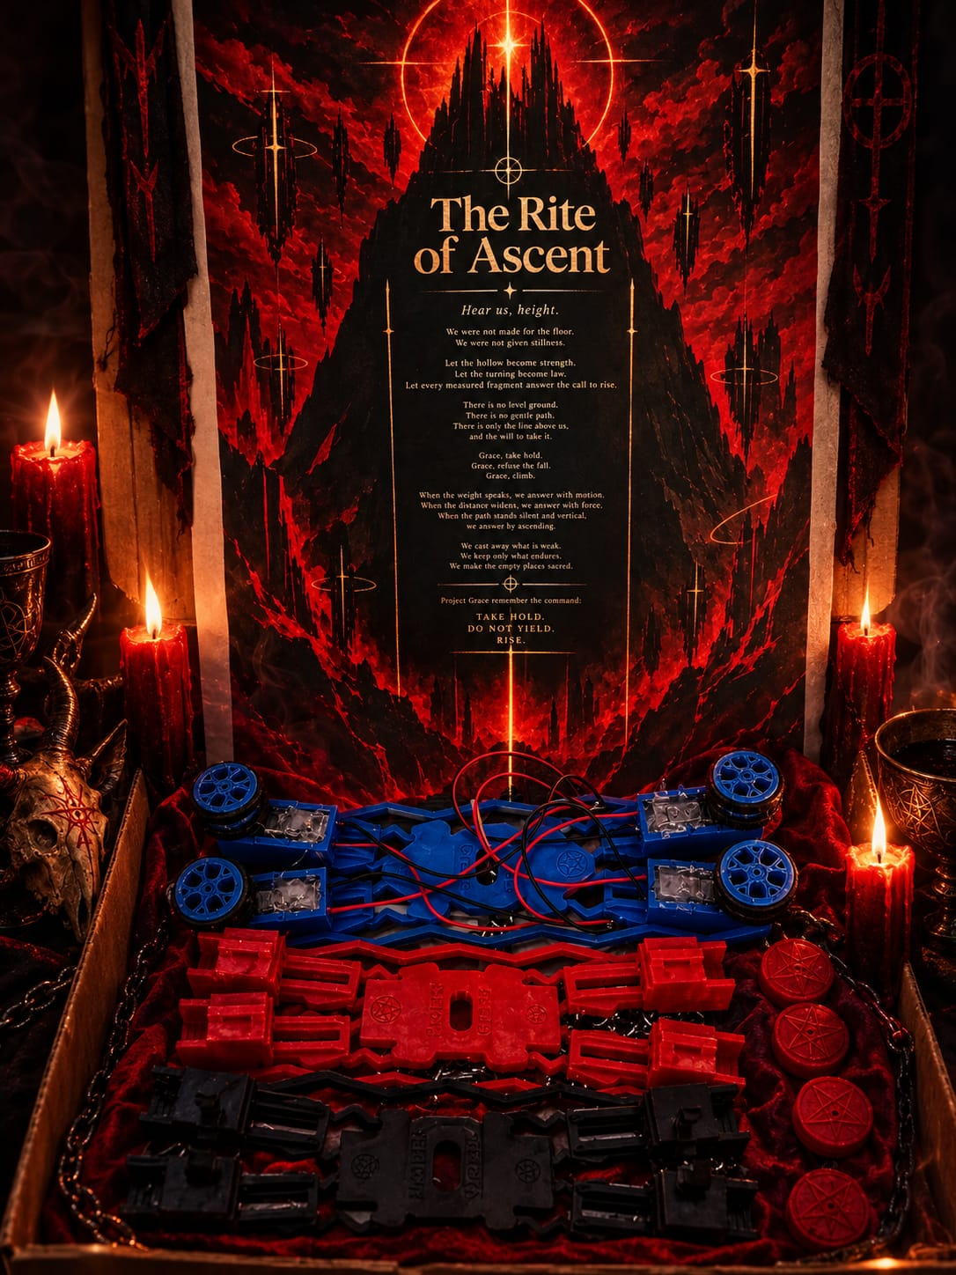

Slide 22
A Frame Built to Yield
and Hold
Project Grace is designed around a simple principle: the frame must flex where movement is useful and remain firm where force must be carried.
Its arms and accordion flexures provide controlled compliance. As the wheels meet the pipe, the flexures can deflect while helping maintain contact and grip. The side springs support that response across the frame. These elements are shaped to bend in intended regions rather than allowing the whole chassis to twist unpredictably.
The centre plate and motor mounts form the structural backbone. Openings remove material where it is not needed, while the arms, braces and mounts preserve paths for forces to travel through the frame. The motor holders keep the motors aligned and accessible, so they can be installed and secured without making the surrounding structure unnecessarily closed.
Each feature has a task: flexures provide movement, wheels provide contact, mounts hold the drive system, and the centre plate joins the assembly. Their dimensions are interdependent. Changing a material, wheel spacing or spring geometry changes how the whole mechanism responds.
Project Grace is therefore neither entirely rigid nor freely flexible. It is a structure tuned to yield without surrendering its hold: enough movement to adapt to the pipe, enough strength to keep climbing.

Slide 23
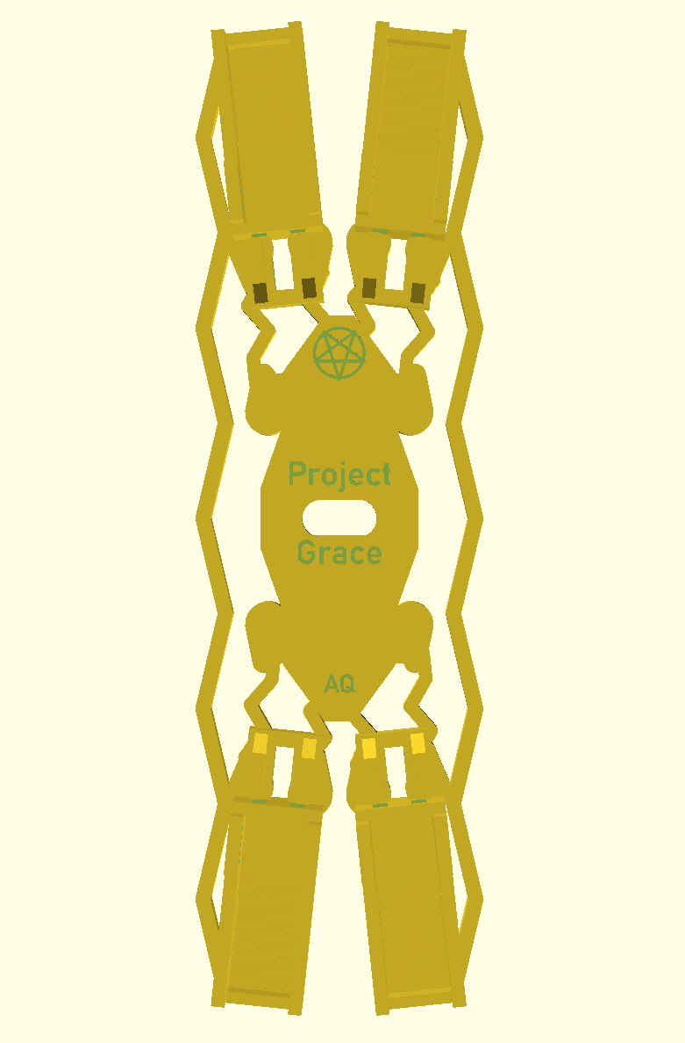

Slide 24
The Wheel: Grip, Guidance, Balance
The Project Grace wheel is designed to do more than turn. It must carry the motor’s force into the pipe while keeping its tyres seated and its shape light enough to respond to the frame.
Its twin tire seats use outer lands and retaining ledges to help resist the tyres walking off under load. The narrowed waist between them provides clearance around the pipe, while keeping both running surfaces joined as one wheel.
The split-spoke pattern removes material between the hub and rim but leaves a continuous outer ring to support the tire seats. The spokes branch outward to connect that ring back to the central hub. This balances open space with a defined structural path for torque.
At the centre, the D-shaped bore transfers rotation from the motor shaft. The one-sided boss provides an adjustable stand-off, positioning the wheel away from the frame without changing the tire profile.
Every feature serves contact, retention or alignment. The wheel is shaped to hold its place, transmit force and keep rolling.

Slide 25
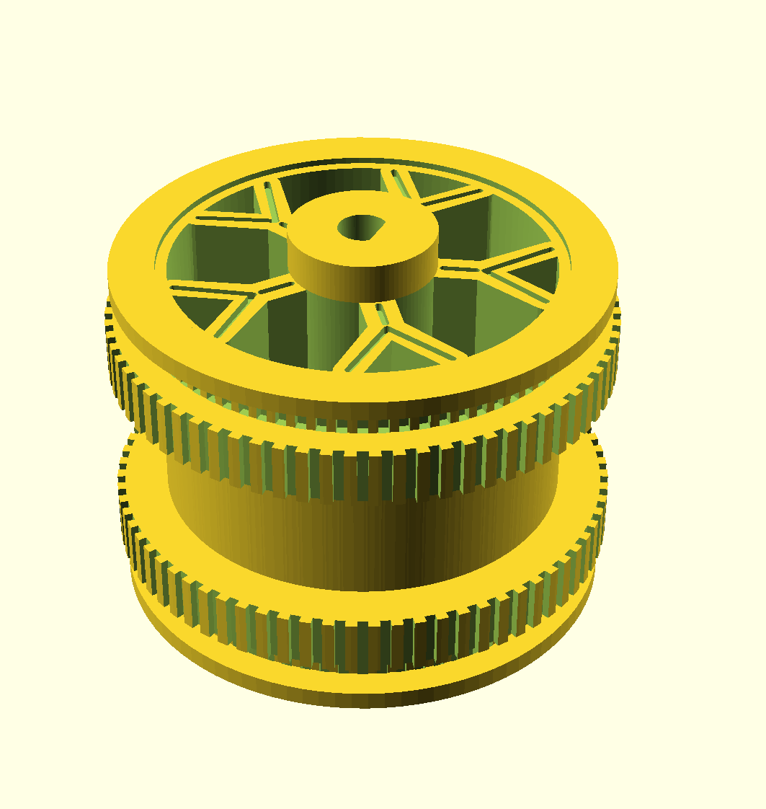

Slide 26
N20 Tyres on the Custom Wheel
Project Grace reuses the rubber tyres supplied with the N20 motor wheels and mounts them on a custom-printed wheel body. This combines the tyres’ existing tread and grip with a wheel shaped to fit the robot’s layout.
The custom wheel has two tire seats, each 6.5 mm wide. Outer lands support the tyres, while raised ledges help keep them aligned under load. A narrower waist separates the seats and clears the pipe. The D-shaped centre bore transfers motor torque into the printed wheel.
The printed body adapts the motor shaft to the paired-tyre arrangement; the rubber remains the part that contacts the pipe. During assembly, check that each tyre is fully seated and that the two running surfaces remain aligned. After testing, inspect for tyre movement or rubbing against the frame. The printed ledges help locate the tyres, but their retention and grip should be verified on the actual parts.
The wheel has to be printed with a gyroid infill pattern at a percentage of 70%, otherwise the D-bore will get easily rounded off. The wheel needs to be bonded to the motor shaft with super glue gel.

Slide 27
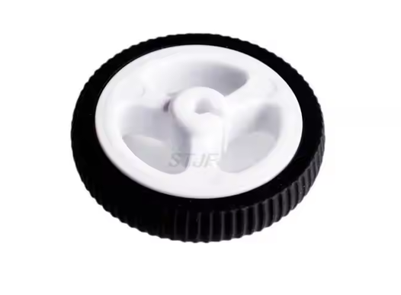

Slide 28
The Bond Between Wheel and Tyre
The bond between the printed wheel and rubber tyre transfers motor torque to the pipe. As the wheel turns, this joint experiences repeated shear; climbing, impacts and tyre deformation can also create local peeling forces. A weak or brittle bond may let the tyre creep around the wheel or separate under cycling.
Project Grace uses Pattex Super Glue Power Gel Control, selected for its stated compatibility with rubber and flexible materials. Its gel consistency helps control application and can accommodate small surface irregularities better than a thin, runny adhesive. The adhesive must still be applied to clean, dry surfaces and allowed to cure fully according to the manufacturer’s instructions.
Cheaper adhesives may have inconsistent bonding, poor rubber compatibility or insufficient toughness. If the bond fractures or debonds, the tyre can slip even while the motor and printed wheel remain intact. That is a shear failure: the driving load exceeds the strength of the adhesive joint.
Use a consistent bond line, avoid contaminating the surfaces, and test the assembled wheel under load before climbing. A quality adhesive improves reliability, but only a physical test can confirm the bond for the actual tyre, print and loading conditions.

Slide 29
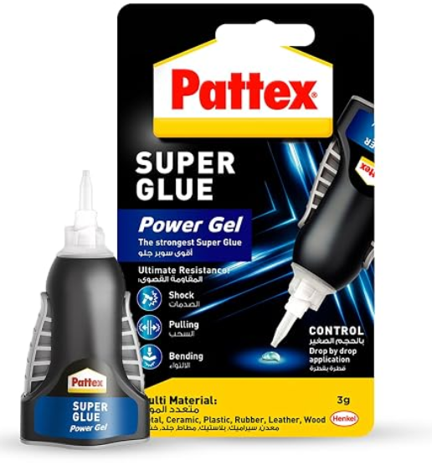

Slide 30
The Chain Hook: Reach with Restraint
The chain hook turns the servo’s rotation into a small, deliberate reach. Its arm carries the hook 20 mm from the servo axis, while the curved tip guides the chain toward an open 6 mm mouth. The rounded profile helps capture the chain without making the end a closed loop.
Force travels from the hook, along the 5 mm-wide arm, into the servo horn and spline. The hub provides the mounting interface; the centre screw secures it to the servo. This makes spline fit and alignment essential: a loose hub can slip, while a poor fit can bind or damage the servo.
The arm balances reach against leverage. Greater reach gives the hook more access, but also increases the moment carried by the arm and servo. The part should therefore be tested with the actual chain and servo, starting with low loads. Print a short spline-fit sample first, then inspect the arm and hook after repeated operation.

Slide 31
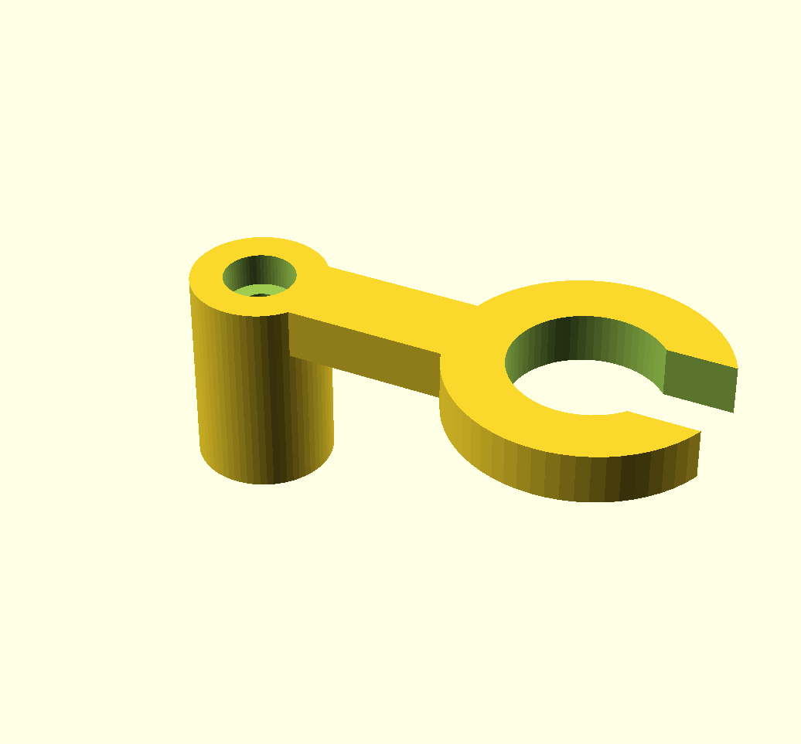

Slide 32
The Battery: Lightness with Reserve
Project Grace uses two identical 2S, 450 mAh LiPo packs in series to form a 4S supply. The combined pack is 14.8 V nominal and 16.8 V fully charged. Series connection doubles the voltage, not the capacity: capacity remains 450 mAh. At nominal voltage, the pack stores about 6.7 Wh of energy. At approximately 22 g per battery, the pair weighs about 44 g, before wiring and connectors.
The system draws roughly 25 W during steady movement and up to 45 W while climbing. At 14.8 V, that corresponds to about 1.7–3.0 A. The theoretical runtime is around 16 minutes at 25 W or 9 minutes at 45 W; real runtime will be shorter due to voltage sag, motor peaks and the capacity reserve needed to protect the LiPo cells.
Use matched packs of the same type, capacity, age and charge state. Confirm that the controller supports a 4S pack’s 16.8 V maximum, and use a suitable 4S balance-charging method. The advertised discharge rating alone does not guarantee real-world performance: verify the pack, wiring and connector under climbing loads.

Slide 33
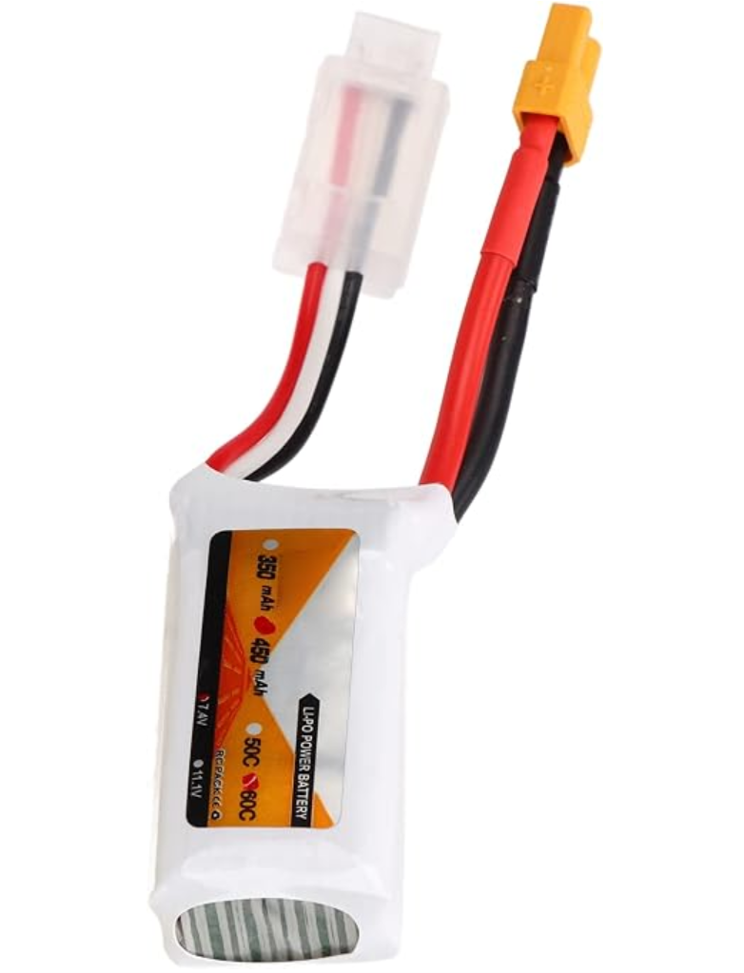

Slide 34
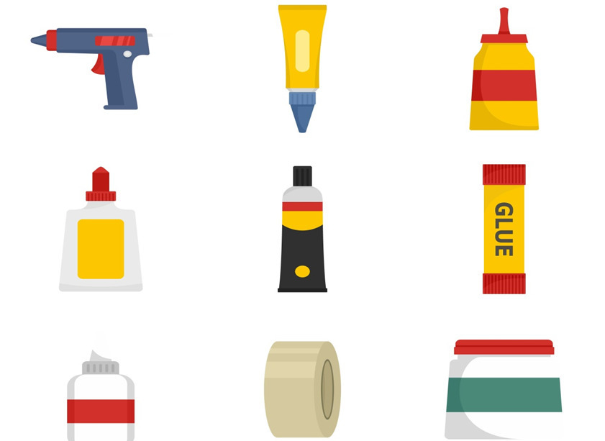
Bonded by Design
Project Grace uses high-performance VHB double-sided tape to secure the battery packs and adhesive to retain selected components. Bonding parts directly to the frame avoids bulky cradles and brackets, reducing printed material, overall mass and print time while keeping the layout compact.
VHB tape’s viscoelastic layer spreads load across a broad contact area and helps absorb vibration. This is useful for battery packs, which should stay positioned as the frame flexes and climbs. Adhesive is also efficient for lighter components that do not need a custom printed enclosure.
The bond depends on preparation: surfaces must be clean, dry and compatible with the chosen tape or glue, with enough contact area and time to cure. Adhesive should not be treated as an unlimited-strength fastener. Check battery retention under vibration and expected loads and remove a taped pack carefully so its protective wrapping is not damaged.

Slide 35
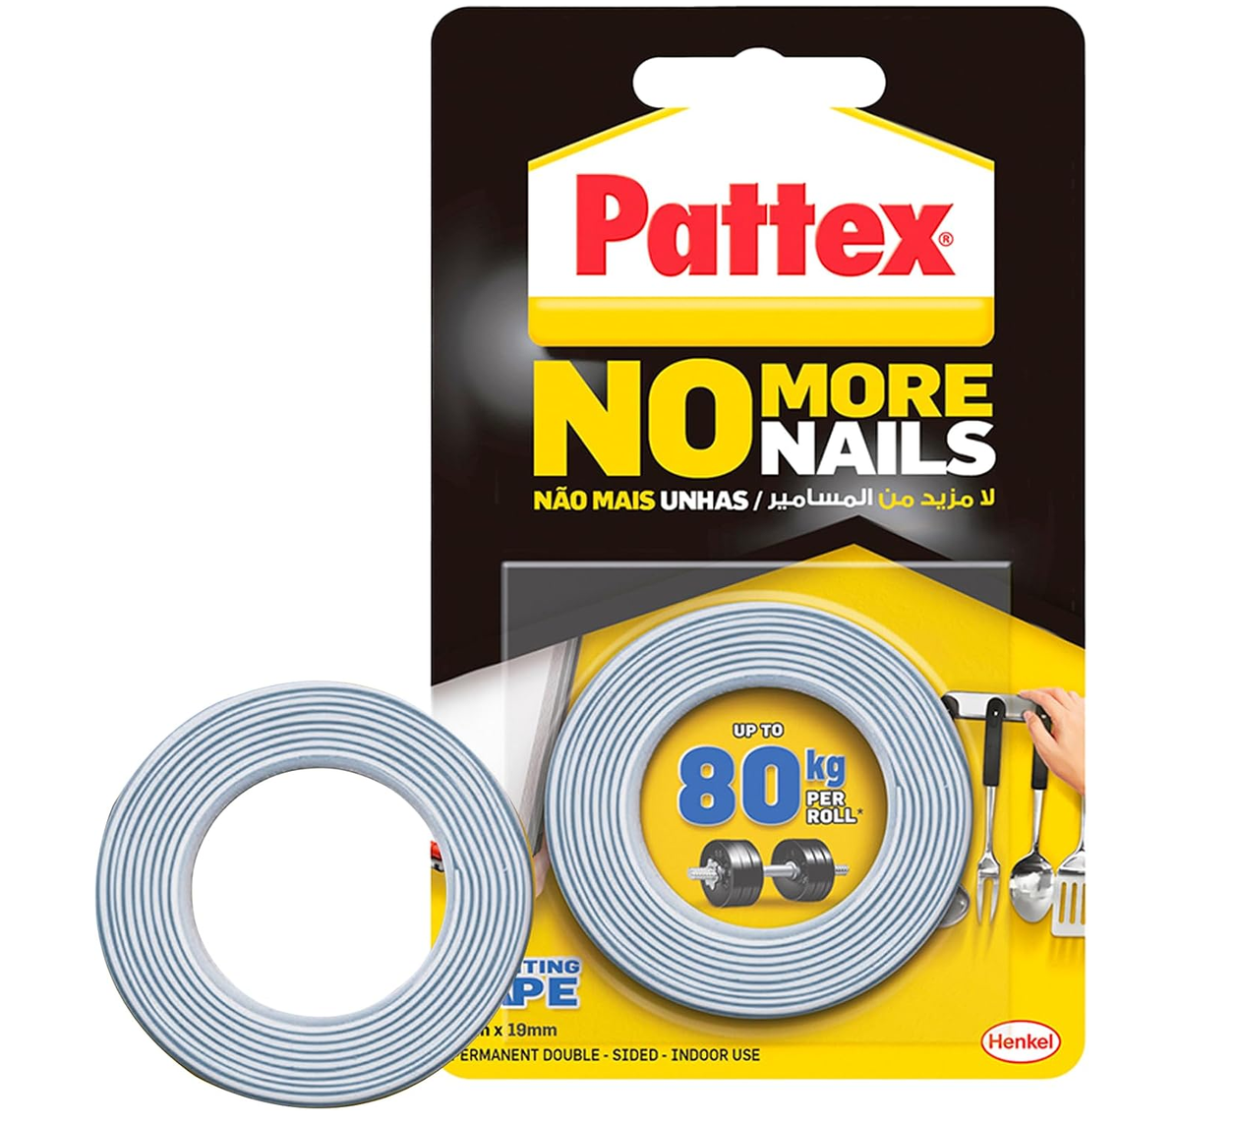

Slide 36

Take Hold
Do Not Yield
Rise

